Slide 1


SOMERSET PURPOSE
Somerset Academy, Inc. promotes a transformational culture that maximizes student achievement and the development of accountable, global learners in a safe and enriching environment that fosters high-quality education.
S - Set high expectations
O - Objective
M - Meaningful curriculum
E - Effective
R - Resourceful and responsible life long learners
S - Scholars who achieve proficiency and beyond
E - Evaluate continuously and use data to drive curriculum
T - Teachers who are highly qualified

Slide 2

DO NOT. . .
“Hang out” in the stairwells or on the second floor during lunch.
Chew gum. DO NOT BRING GUM!
Go on the basketball court with a skateboard!
Use the elevator without approval from the office.
Leave campus if you are a Middle Schooler, Freshman or Sophomore (Except for DE students)
Allow an underclassmen in your vehicle without prior permission, or you will lose all privileges for the remainder of the school year.
Throw anything off the balcony.
Throw anything from the ground level to the 2nd floor.
Eat or carry food over the basketball court or turf field
Litter or leave garbage around at lunch
Hang out by the wavy wall side or behind the basketball court bleachers
Hang on or grab the basketball nets/rims
Playing “keep away” = a detention
Yoga pants/ leggings/ are not allowed. Not even during dress down days. Dress code violations earn detentions
You are not to go to the Deans’ office during class to argue a detention. You will be turned away.

Slide 3
Discipline
Discipline is applied with mutual respect in a firm, fair , reasonable and consistent manner.
Preventive Morning announcements, Teacher and School's Rules & Expectations
Supportive Warnings for students to get back on task. Email notification to parents
Corrective Weekly Monday Detentions, Monthly Saturday Detentions

Slide 4
Somerset College Prep Discipline Matrix
*Warnings* Do Not apply to all discipline. Teacher & Staff discretion
DETENTION
SATURDAY DETENTION
SUSPENSION including DISMISSAL
3:50 to 4:50pm
Classroom Disruption
Disruptive Conduct
Chewing Gum
Bus Violation
Disrespect for others
Disrespect for property
Littering during lunch
Electronic Confiscation
Public Display of Affection / P.D.A
Profane Obscene Abusive Language
Running in the Halls
Spray used in the Restrooms
Tardy to Class
Tardy to School ( 3 late arrivals non bus rider)
9:30 to 12:30pm
Horseplay
Missed Detention
Multiple Detentions
Disruptive Conduct
Bus Violation
Skipping = 2 Saturday Detentions, Referral & 9 week Behavior Probation Contract
Cheating = 3 Saturday Detentions, Referral & Behavior Probation Contract
Excessive Detentions / Unserved Detention
Theft
False or Misleading Info
Open Defiance of Authority
Vaping
Physical Altercation
Fighting or Attempting to Fight
Assault / Intimidation Threat of Student
Weapons
Other Major Misconduct

Slide 5
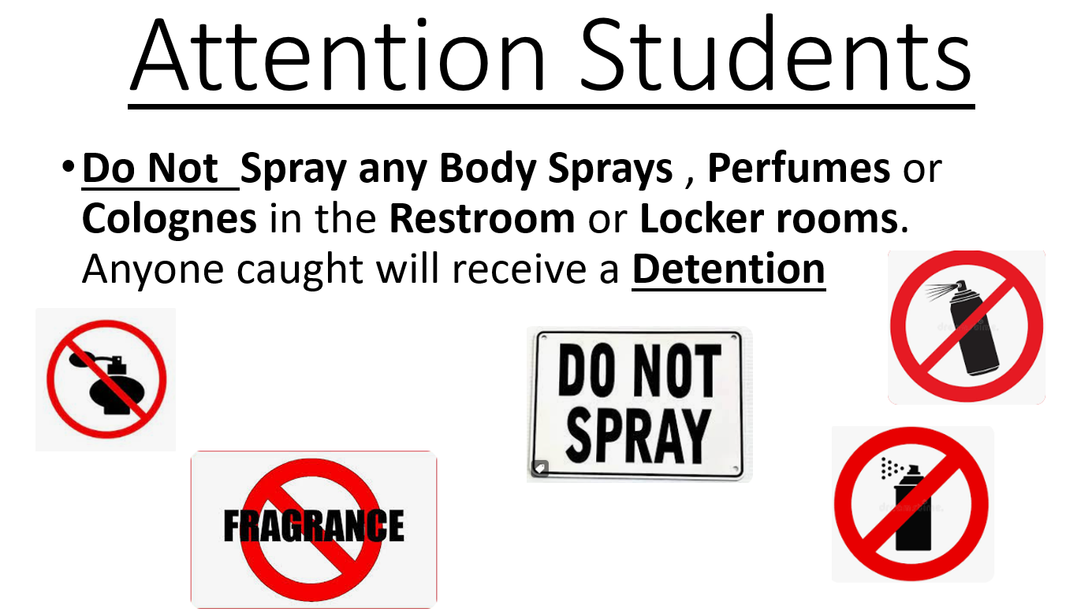

Slide 6


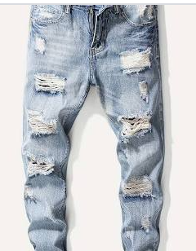
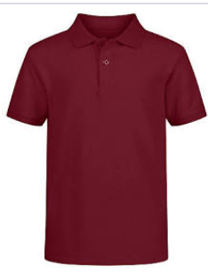
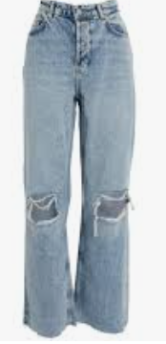
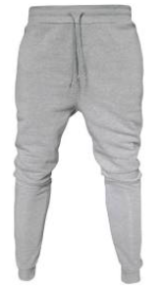




Dress Code Violations (Do Not Wear)
Ripped or Frayed Jeans
Non - Somerset, Hoodies or Polos
Crocs, Slides & Foam Runners
Sweatpants, Joggers, Yoga pants, tights or Pajama pants

Slide 7
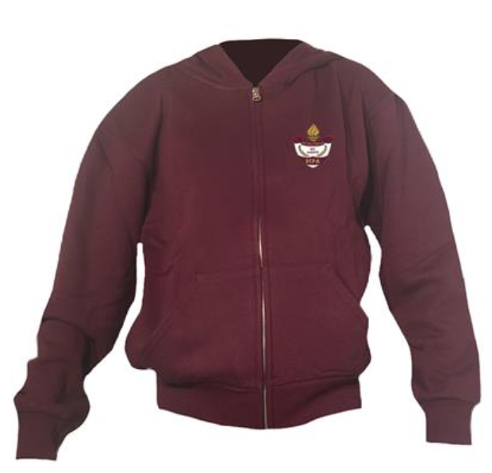
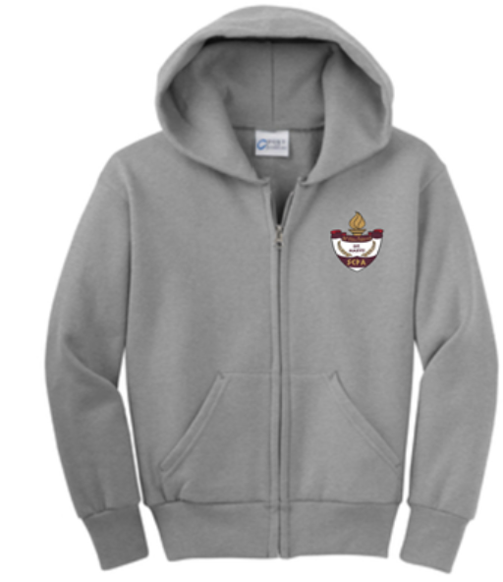
Dress Code Violations
A Somerset College Prep shirt must be worn underneath a zip up Hoodie or Jacket.
Exceptions would include
House Shirts on Thursday's
School Friday Shirts
Club Shirts
School Athletic apparel for game days.
Anyone not in compliance will be given a Dress Code Violation according to our Discipline Matrix.

Slide 8
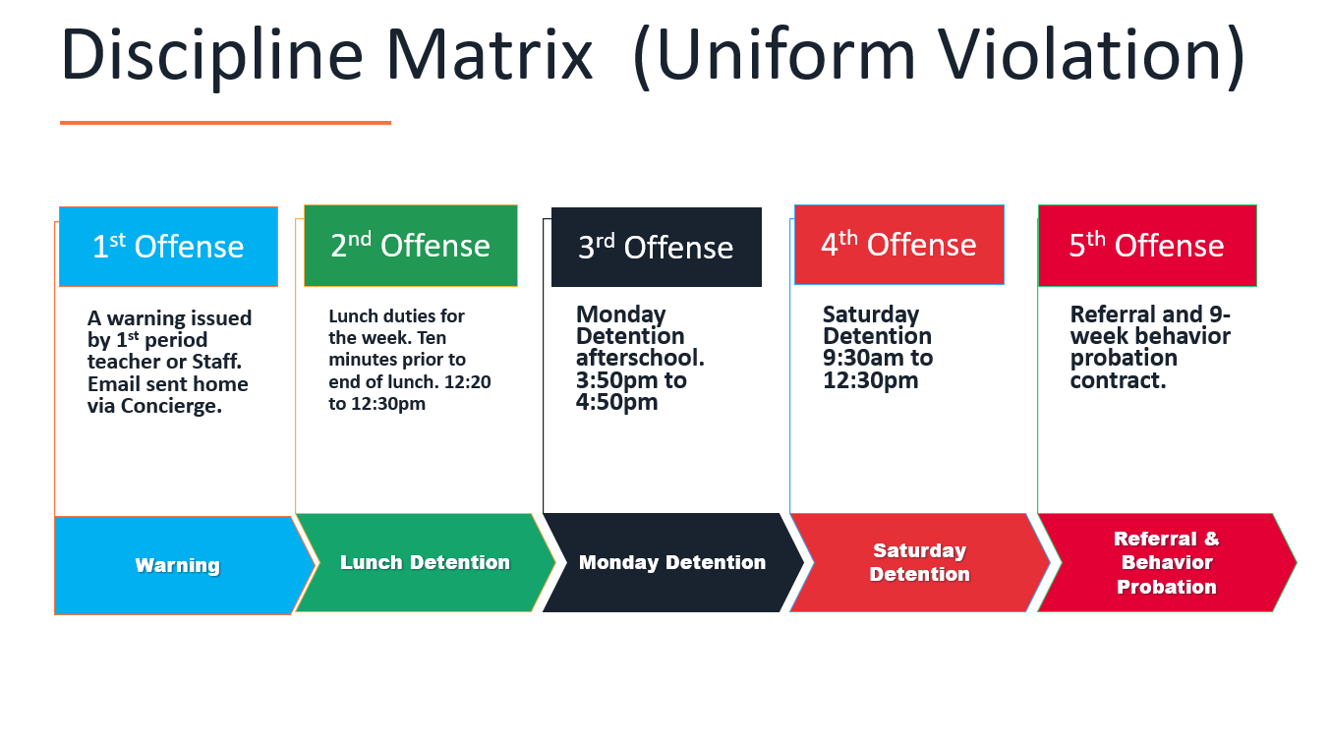

Slide 9
Dress Code (What can I wear)
School Appropriate Attire
OK
Solid Color Shorts (Fingertip length or longer)
Denim, Khaki, Cargo & Jean Shorts
House Shirts
Club Shirts
Skorts, Capris Any color
Not OK
Spandex Material
Rips , Tears or Frays
Sweatpants, Yoga pants
Tank tops
Leggings
Bottoms with print or derogatory slogans

Slide 10
Dress Code Violations
A Somerset College Prep Shirt must be worn underneath a zip up Hoodie or Jacket.
Shirts include
House Shirts
School Friday Shirts
Club Shirts
School Athletic apparel for game days.
Anyone not in compliance will be given a Dress Code Violation according to our Discipline Matrix.

Slide 11
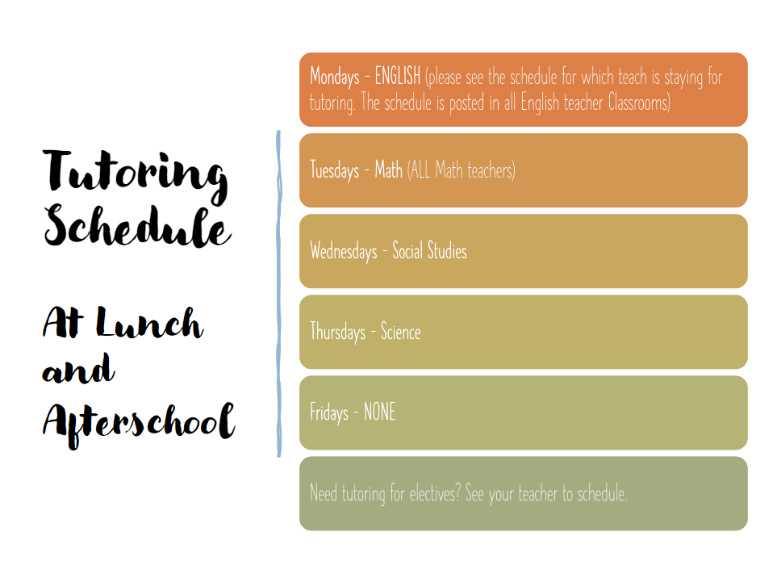

Slide 12
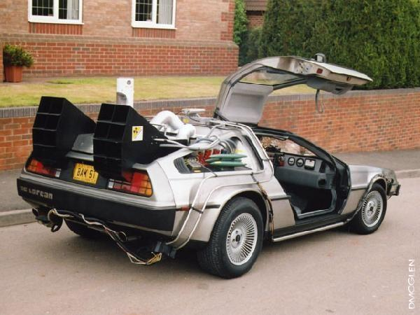
Tardy—being late to class.
Being tardy to periods 2, 3, or 4 is accompanied by a detention.
Period 2, 3, 4 teachers write & submit the detention.
Being tardy to 1st period is a detention if you are a bus rider and your bus was on time.
Being tardy to 1st period and you are not a bus rider is a detention for every 3rd occurrence.
*Does not apply to excused tardies.

Slide 13
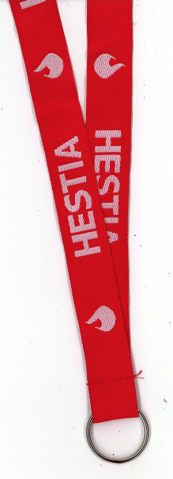
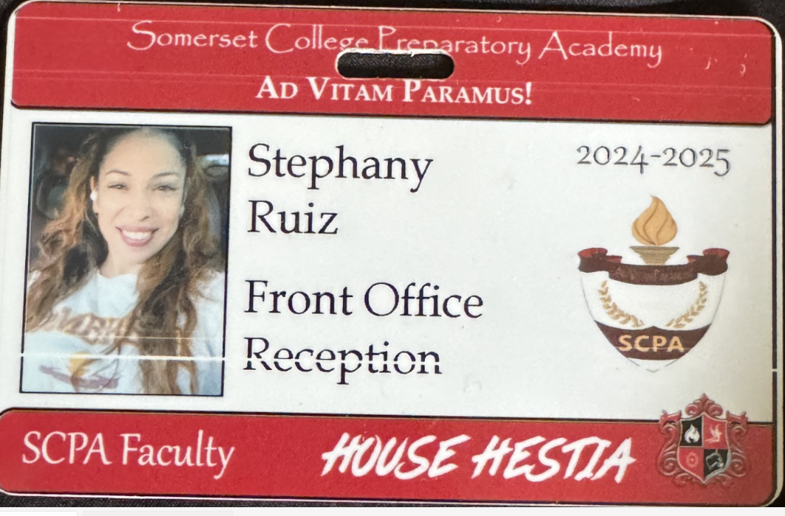
Lanyards and IDs are a Mandatory
Part of your uniform
Keep in your backpack
Needs to be worn everyday you’re at school
No Lanyard and ID will result in a dress code violation.

Slide 14





No Sports on Turf Afterschool without a Coach

Slide 15

NO FOOD ON THE COURT

Slide 16
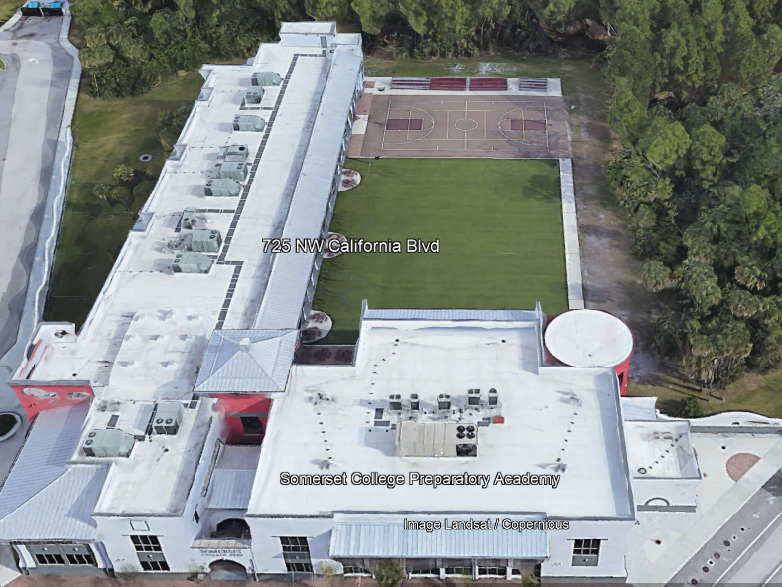

There is NO open food or liquid on the turf!!!
If you are caught, you will be having a meeting with the deans
TURF!

Slide 17
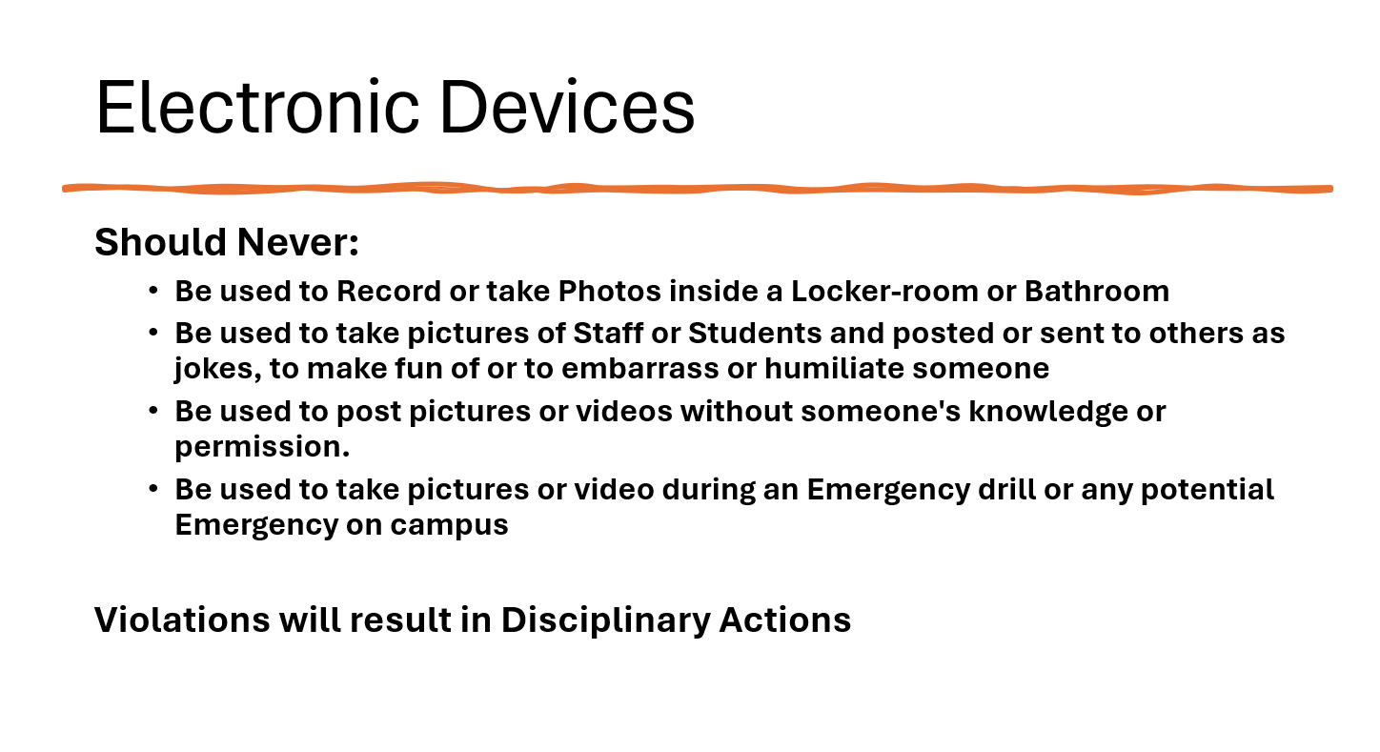

Slide 18
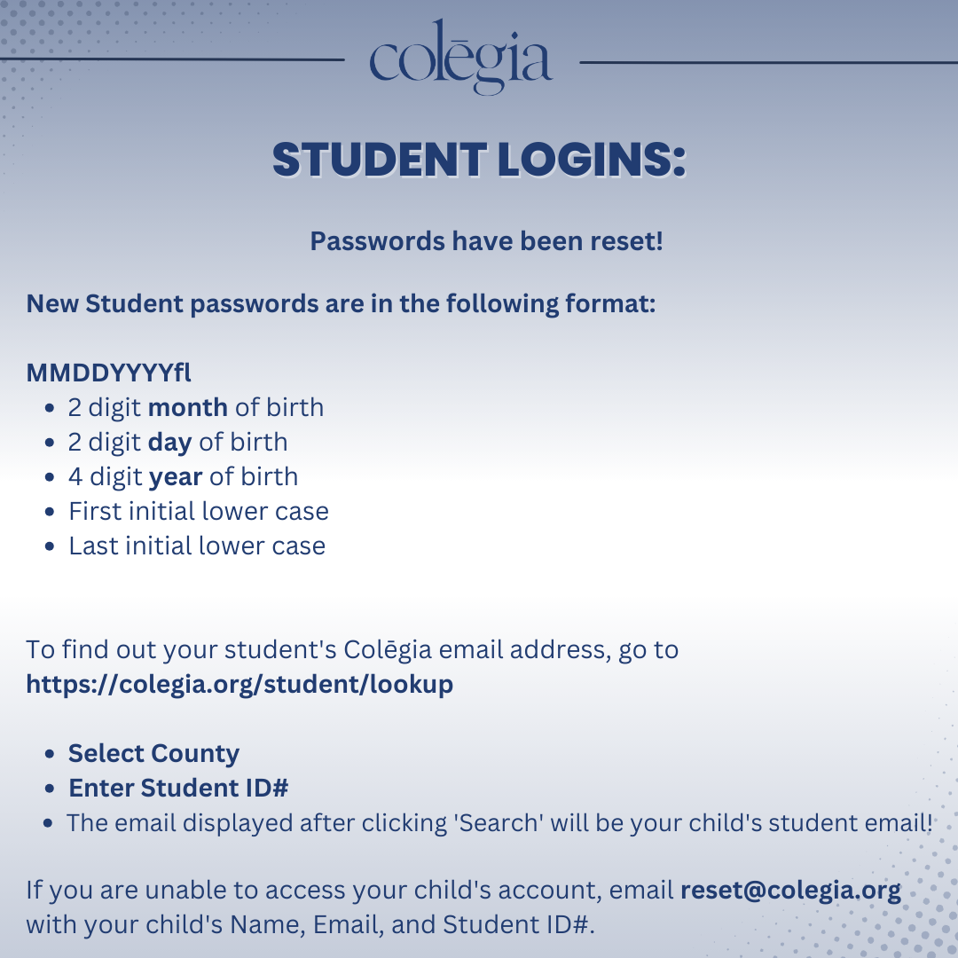

Slide 19

Daily Dress Code Checks
During Morning Announcements
3 Random classes will be selected
to receive a Dress Code check by the Dean

Slide 20
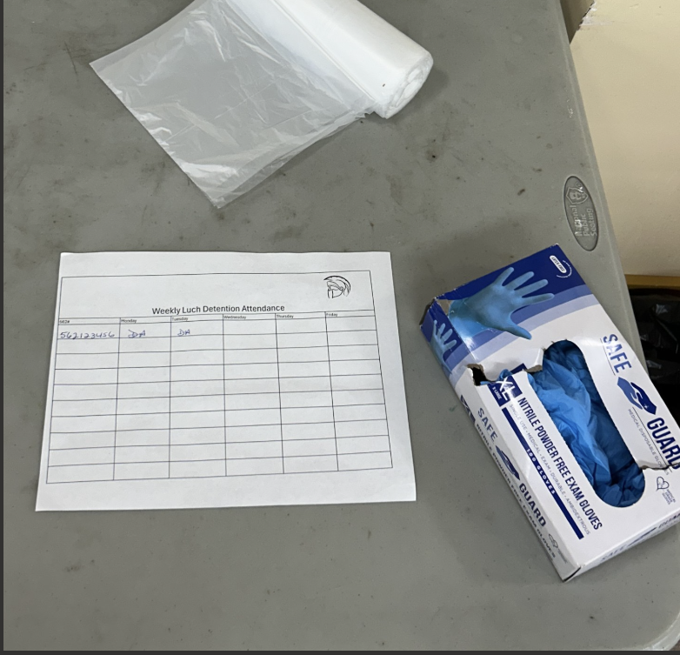


NEW Lunch Detention Procedure
Lunch detention will be the entire week Monday to Friday
Each day at 12:20 students need to report to the cafeteria
Initial the sign in sheet for the day
Retrieve 1 glove and 1 bag from table inside cafeteria
Assist with picking up trash and trays left behind by students around campus
Cameras will be reviewed to ensure Detention was served.

Slide 21
Student Parking
Only students with a parking permit may park on campus.
1st Violation: Warning
2nd Violation: Detention
3rd Violation: Revocation of Parking Permit
Non-Permitted Parking: TOWED at OWNERS EXPENSE

Slide 22
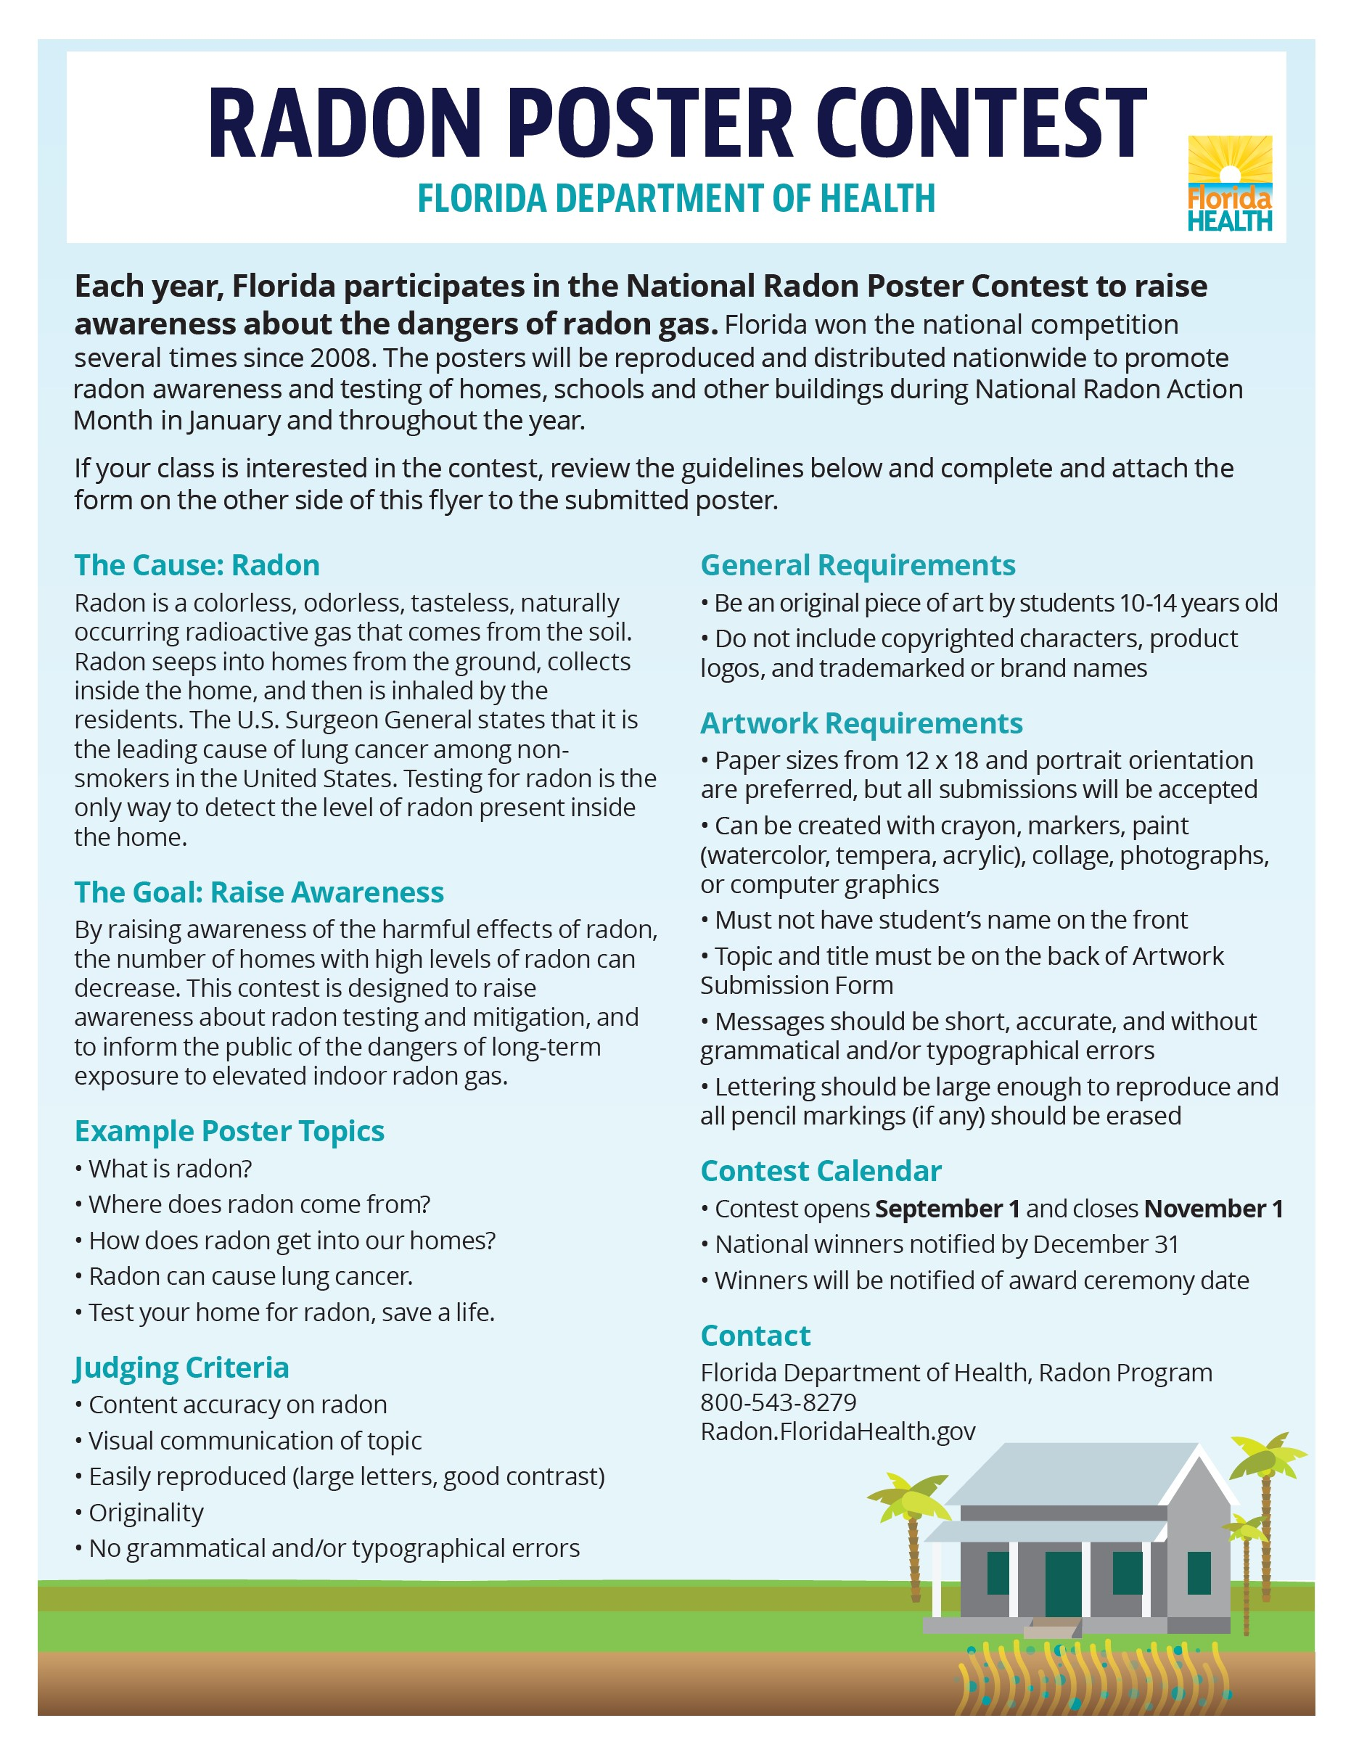
Radon Poster Contest:
SCPA Students
Ages 10-14
Entries Due to our art teachers no later than October 15th!
See Art teachers Mrs. Douglas(rm 267), Ms. Daniel(rm 274) or
Mr. Gebert(rm 235) for more info & entry form!

Slide 23


Slide 24
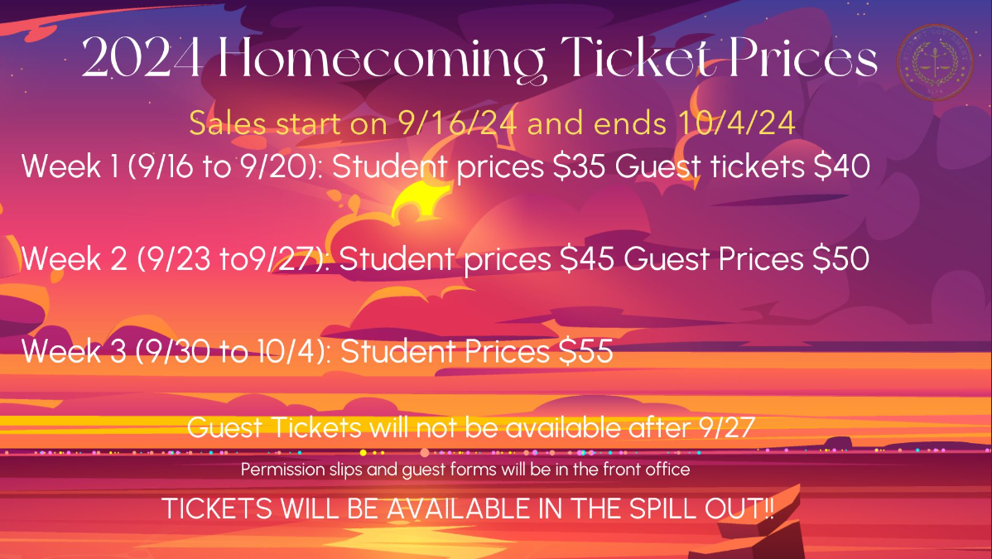

Slide 25
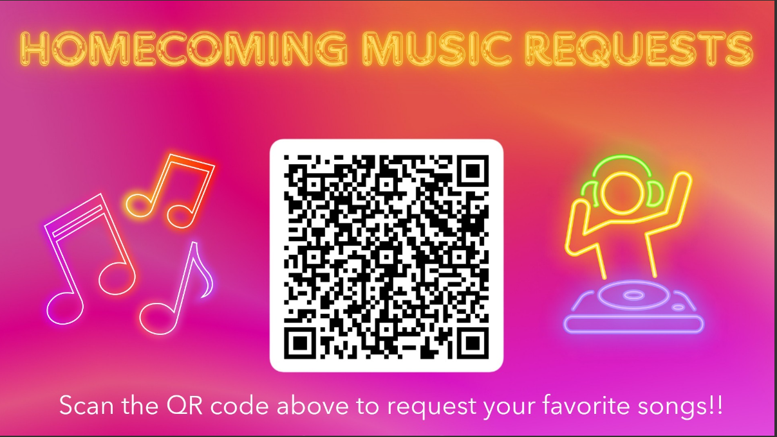

Slide 26

Worried about the Florida Civics Literacy Test and you’re a current 11th grade government student?
Come to room 169 during lunch on Wednesdays for additional help!

Slide 27


SCPA/SCA
PTSO Meeting
Mark your calendar!
SCPA/SCA Cafeteria
Tuesday, October 8th
6-7 pm
Bring any extra Classroom supplies/ Donations for volunteer hours & house points!
Questions or want to get involved?!?
Email
PTSO@somersetcollegeprep.org

Slide 28

Mark your calendars for the Second Annual
SCPA Haunted School!
Sign up for individual scare actors
&
volunteers will come out early October!
Save the Date!
Saturday, October 26th
6 pm – 9 pm!

Slide 29
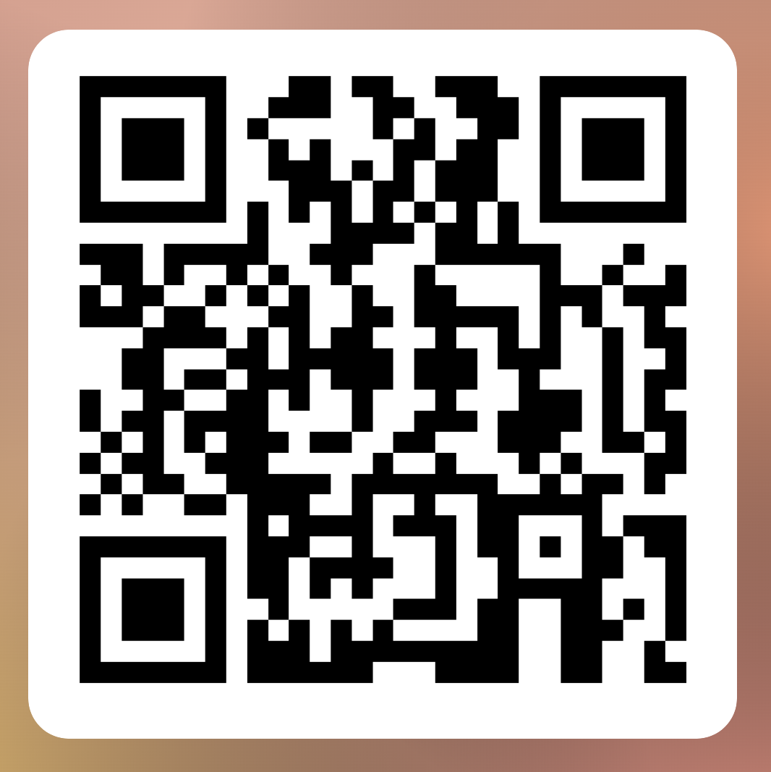
Want to participate in the 2025 Haunted House AND raise funds for YOUR club?
Complete the
online form to let the PTSO know you’re interested.
Clubs will share the profits raise!
Your club must be able to:
Attend the Planning meeting after school Tuesday 9/24 (at least one representative)
Planning & Securing the decorations for your scare scene(s).
Arrive early (Saturday 10/26) to set up, participate in the event & clean up our section.
  Set up begins as early as noon.
  The event is over at 9 pm to begin clean up.
Sign up for individual scare actors & volunteers will come out later!

Slide 30


Slide 31


Slide 32
Interested in joining National Art Honors Society?
Requirements:
3.5 Overall GPA
3.5 Art GPA
Must participate in 10 art volunteer hours/year
High School Standing
Must have completed at least 2 High School
Level Art Classes
Interested? Questions? Need an application?
Email:Douglas.Jennifer@somersetcollegeprep.org
Go to Room 267C

Slide 33
Science National Honor Society (SNHS)
SNHS Applications are OPEN!
Pick up an application from Mr. Ludwig’s room (247)
Deadline for submission: September 23rd ludwig.eric@somersetcollegeprep.org
SUBJECT: SNHS
Qualifications:
3.5 overall GPA
3.5 UNWEIGHTED GPA in all science courses
2 subsequent science courses within the same subject like Biology I Honors (High School level) and Biology I at IRSC.
Example: Chemistry I Honors(High school level) AND Chemistry I at IRSC (or an AP level Chemistry)

Slide 34
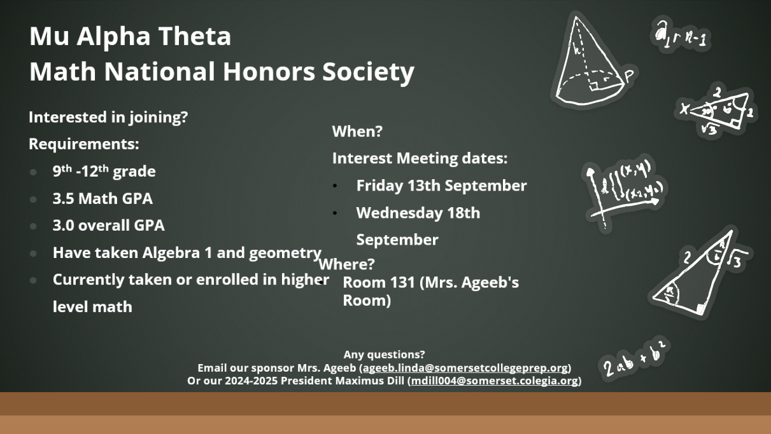

Slide 35
Are you Interested in Joining National Honor Society?
Apply Now!
To apply for NHS, you must:
Have at least a sophomore standing
Have an unweighted GPA of at least 3.5
Have taken at least one honors level course or higher each year in high school
Have at least 75 volunteer hours
Have no referrals
Applications and teacher recommendations can be found on the school website and are due to oconnor.abby@somersetcollegeprep.org at 3:00 PM on September 23rd!

Slide 36
Win the Test!
Strategies applicable for any standardized test
including PSAT, SAT, BEST, FAST, etc.!
Especially great for students who may experience test anxiety!
Tuesdays After School - ONLY
Sessions Begin Tuesday, October 1st.
Test Taking Strategies to beat the test writers at their own game!

Slide 37


Girls and Boys Soccer Club
Tuesdays and Thursdays
Will start September 3, 2024, from 4pm-5:15pm
On the Turf at SCPA.
Please be on time to pick-up at 5:15pm.
Will be on Sept 3,5,10,12,17,19,24,26 and Oct. 1,8
Remind Codes: For notifications
  Send text to 81010 and text this message: @2425socc
  https://www.remind.com/join/2425socc

Slide 38
School Clubs
Chorus- Highschool: Afterschool 4-5:30 Mondays in 268C
D&D Club- Mondays, afterschool, in 175C, from 3:50-5:15
Movie Club- Mondays, at lunch in 234A
Boxing Club- Outside on the turf afterschool, on Mondays, Wednesdays, and Fridays
Florida Future Educators of America (FFEA)- Tuesdays at lunch in 164C
Artists for a Cause- Tuesdays at lunch in 268C and 2nd Wednesday of the month, afterschool in 268C
Poetry Club- Tuesdays, afterschool, in 223A
English as a 2nd Language Tutoring- Tuesdays, during lunch and afterschool, in 124A from 4-5pm
Community Service Club- Wednesdays at lunch in 232A
Student Government Association (SGA) - Wednesdays, Afterschool in 226A
Chess Club- Thursdays at lunch in 234A
Chorus- Middle School: Afterschool 4-5:30 Thursdays in 265C
Spartans Against Destructive Decisions (S.A.D.D) – Thursdays at lunch in 129A
Science Olympiad- Fridays at lunch in 247B
First Priority- Friday, at lunch, in 263C
Music Club- Fridays at lunch in 241B
GSA- Fridays, at lunch, in 169C
Guitar Club- Fridays, afterschool from 4-5pm in 169C

Slide 39

Interested in starting a school club?
If you’re interested in starting a school club, you should do the following:
  Find a teacher to sponsor the club. Give them the details about the club so they know if they’re able to sponsor the club.
  Create a petition and get students who would be interested in your club to sign it. This shows that your club has generated interest.
  Talk to someone in administration about getting your club approved. Tell them who the sponsor is, when the club will occur (lunch or afterschool), and what the club entails.
  Email Mr. Kyryliw (Kyryliw.Michael@somersetcollegeprep.org) the information about you club and a slide advertising it. I will leave the advertising slide up for a week or so and create a slide listing all the club information for easy reference.

Slide 40


Somerset College Prep &Public Wireless ACP Program
This document will also be in the front office for you to scan the QR code.

